Slide 1

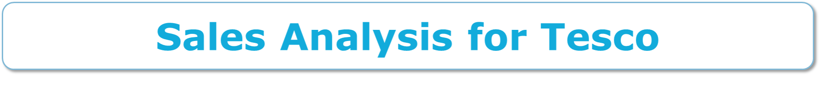
By
GUNTURU SAI KRISHNA VARMA
(189875)

Slide 2
Introduction
To develop a data model in SAP BW/BO to analyze sales for Tesco based on parameters like customer, outlet, sales region, Sales Document, Sales Organization, Sales representative, Sales Group and Material.
To develop a data model in SAP BW/BO to analyze sales for Tesco based on parameters like customer, outlet, sales region, Sales Document, Sales Organization, Sales representative, Sales Group and Material.
SAP Business Objects (SAP BO) serves as an integrated query, reporting and analysis solution for business professionals.

Slide 3
Master Data Attributes
Create Attributes for the following for the following master data entities
Customer Id
Customer Location
Customer Name
Material Group
Material Id
Material Name
Outlet
Sales Region
Sales Representative
Sales Office

Slide 4
Key Figures
Create Key Figures for the following data entities
Price
Quantity
Sales Revenue
Tax
Amount

Slide 5
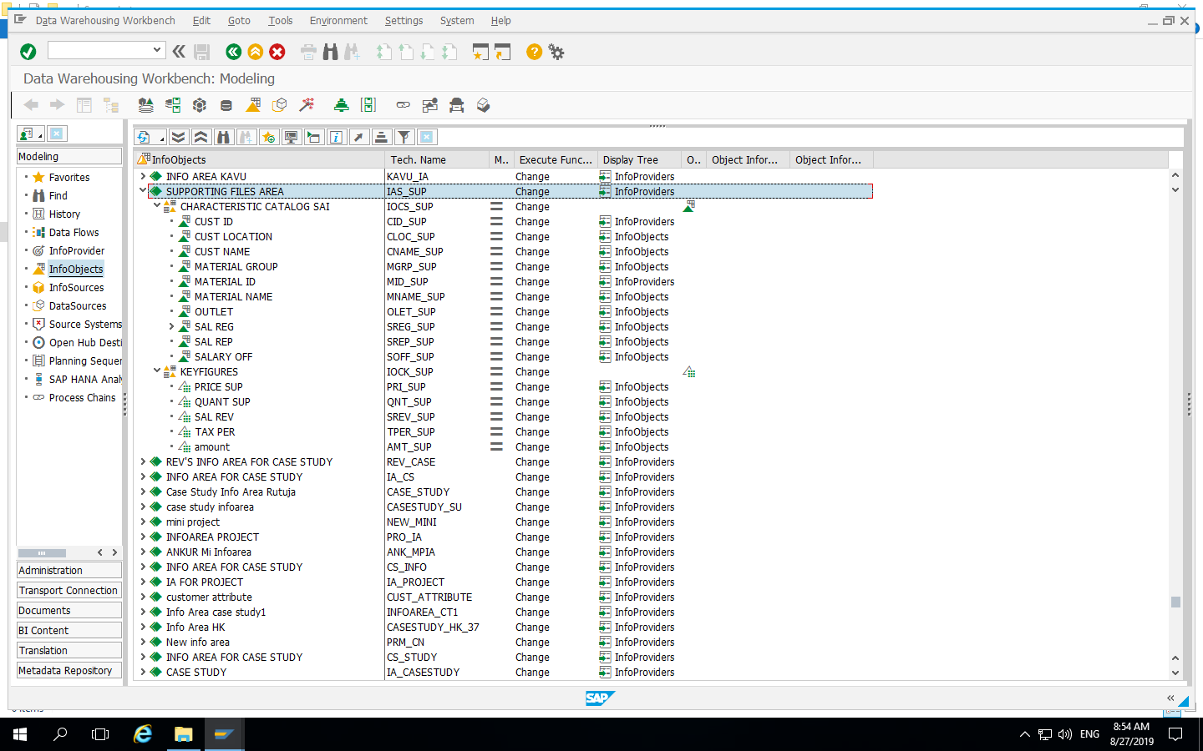
Created Objects Based on business requirement as shown below

Slide 6
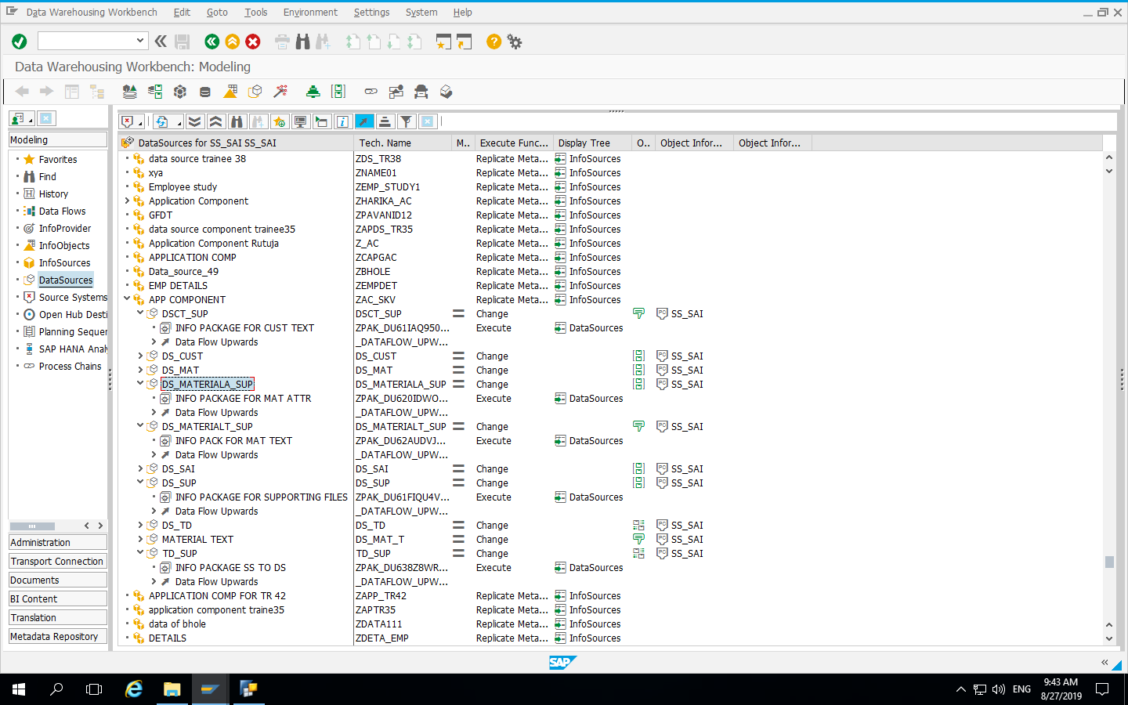
Created Source system, Application component and required Data sources and info packages as shown below

Slide 7
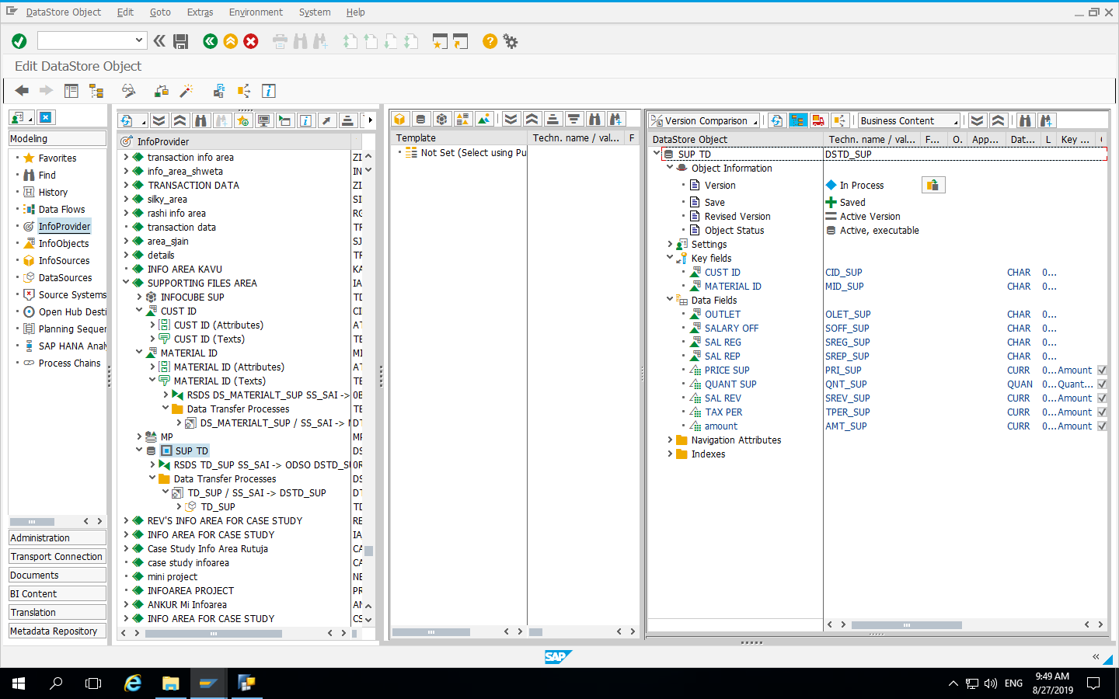
Created Data Store Object with respective Data fields and key fields

Slide 8
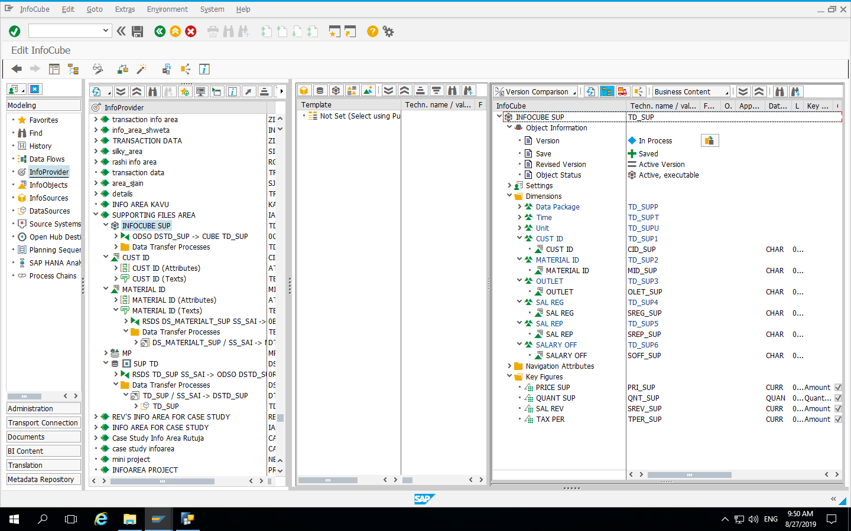
Created Infocube with respective Dimensions and Key fields

Slide 9
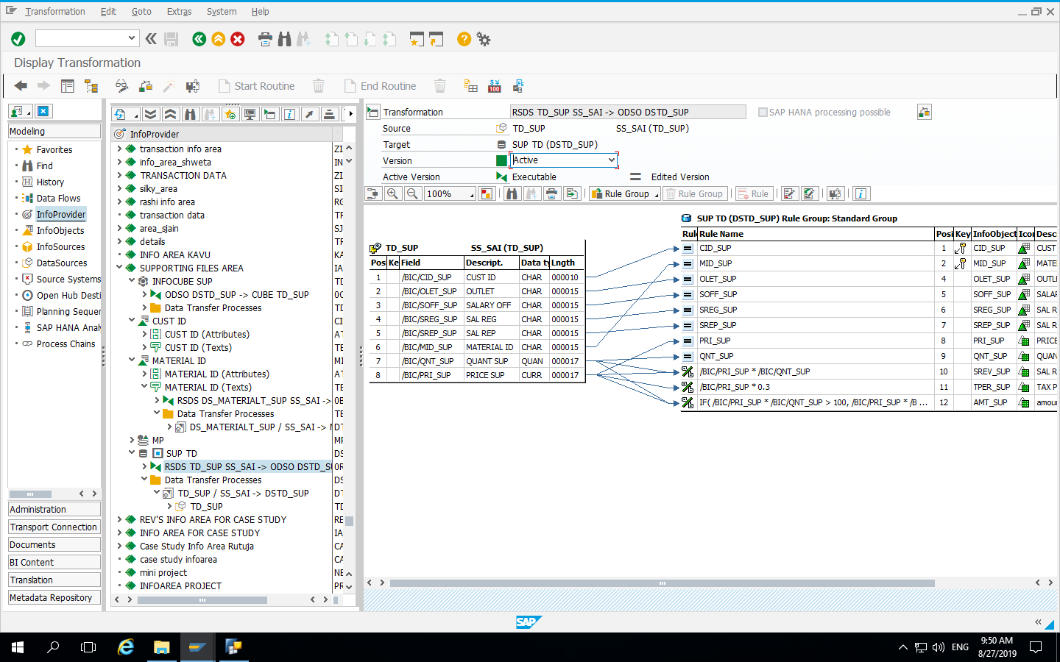
Transformations between Data Source and Data Store Object

Slide 10
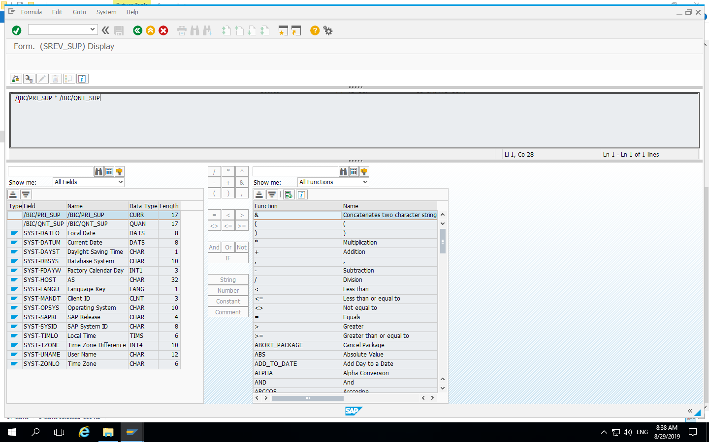
Generated Formula for Sales Revenue using Price and Quantity entities

Slide 11
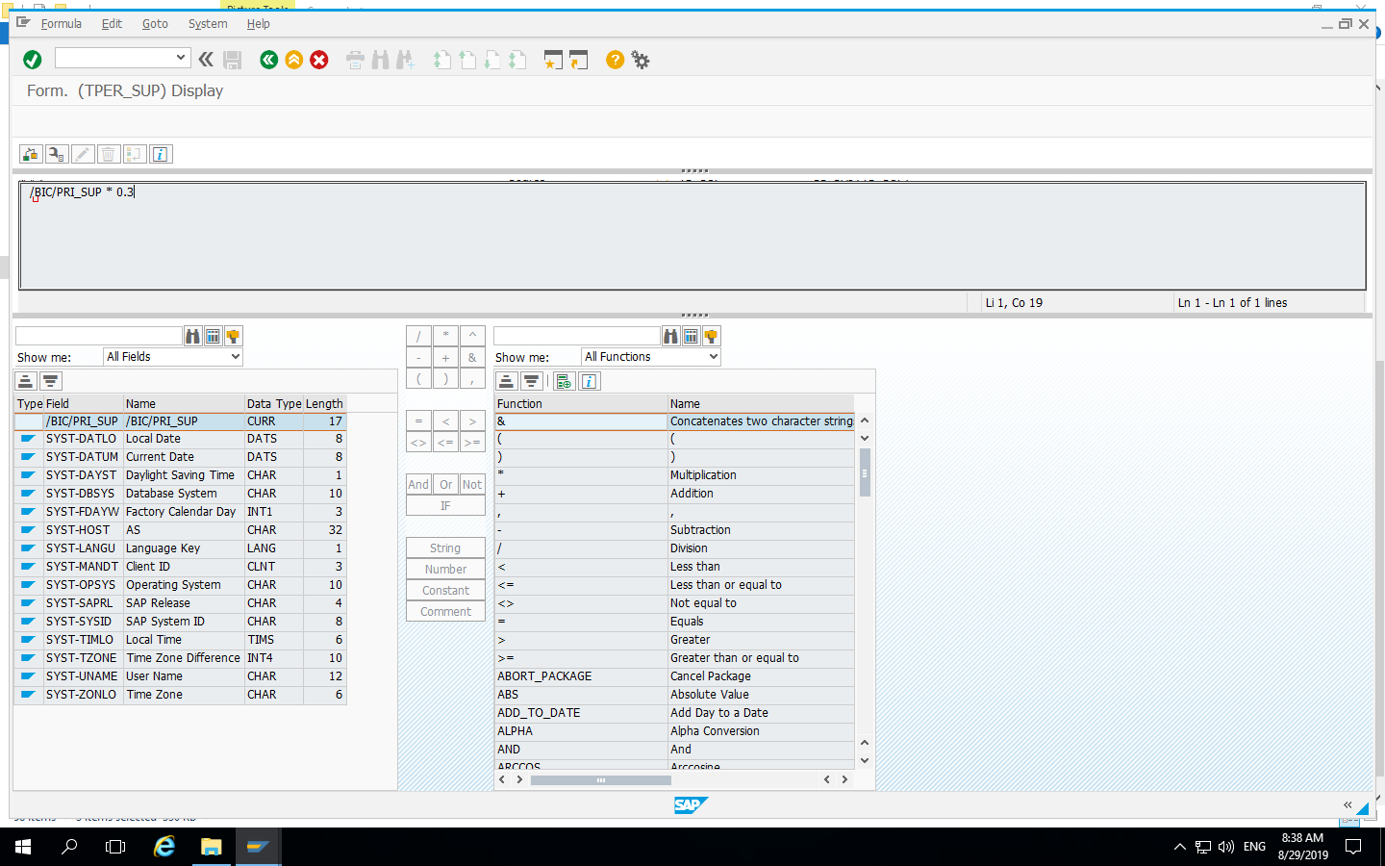
Generated Formula for Tax using Price entity

Slide 12
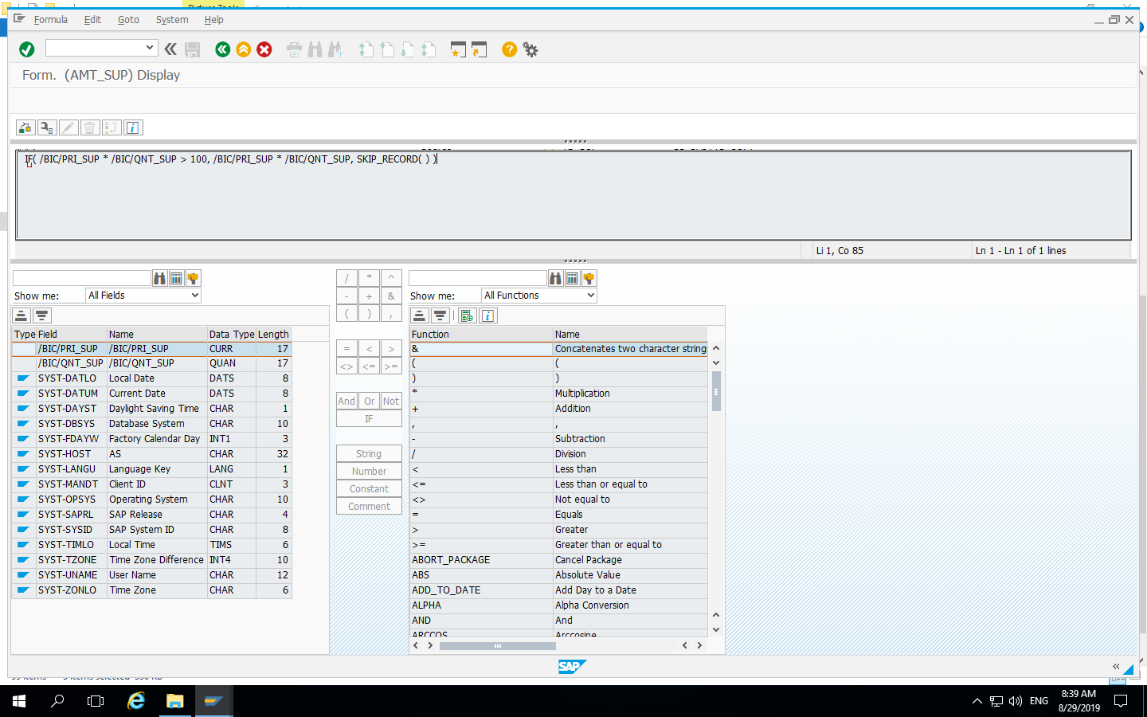
Generated Formula with conditions for Amount using Price and Quantity entities

Slide 13
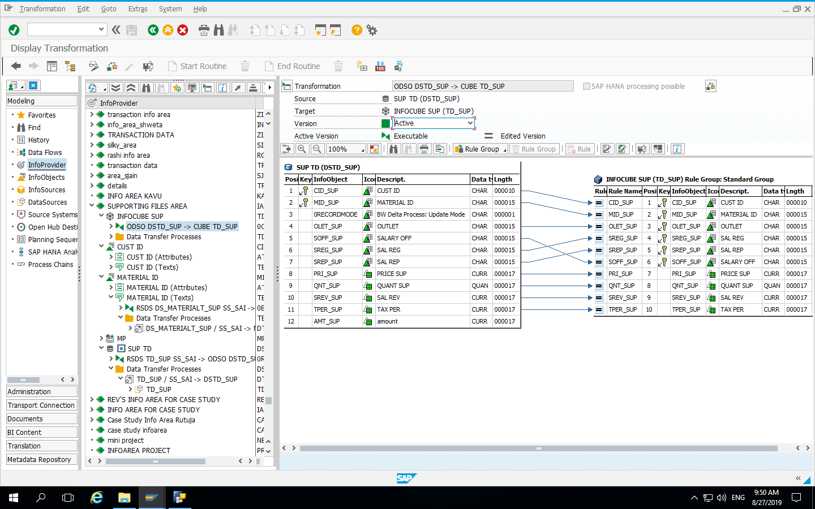
Transformations between Data Store Object and Infocube

Slide 14
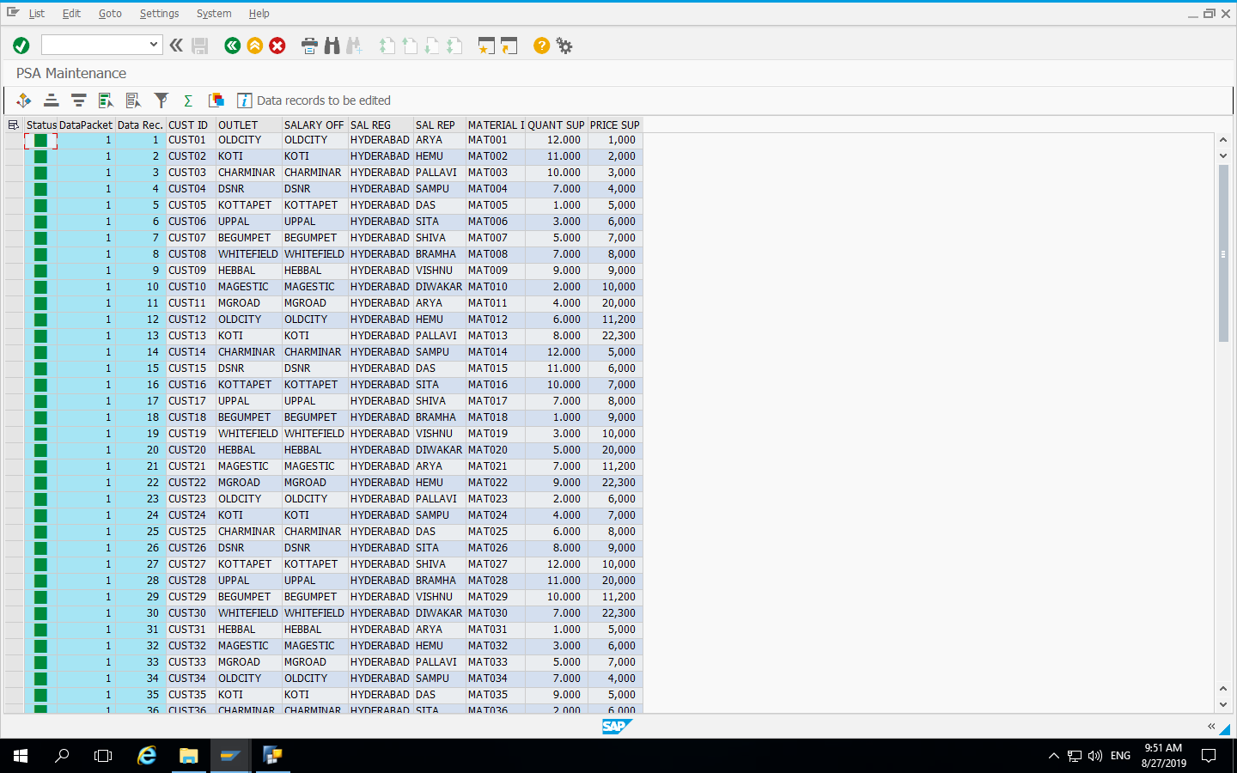
Activated Infopackage and Data in PSA is as shown below

Slide 15
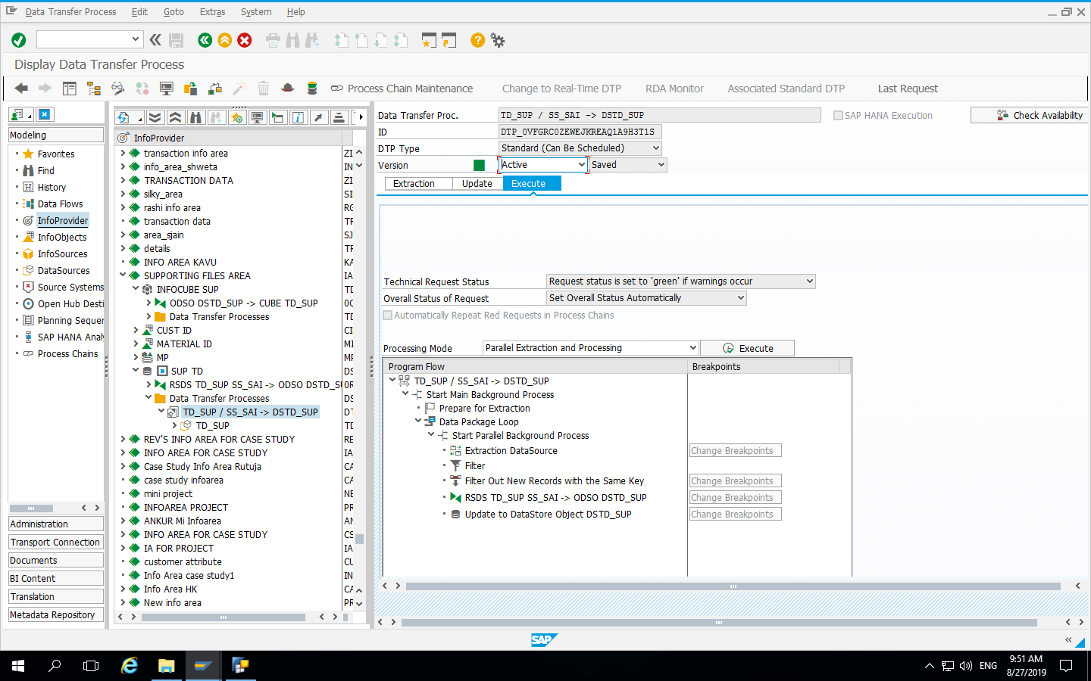
Execution of Data Transfer Process

Slide 16
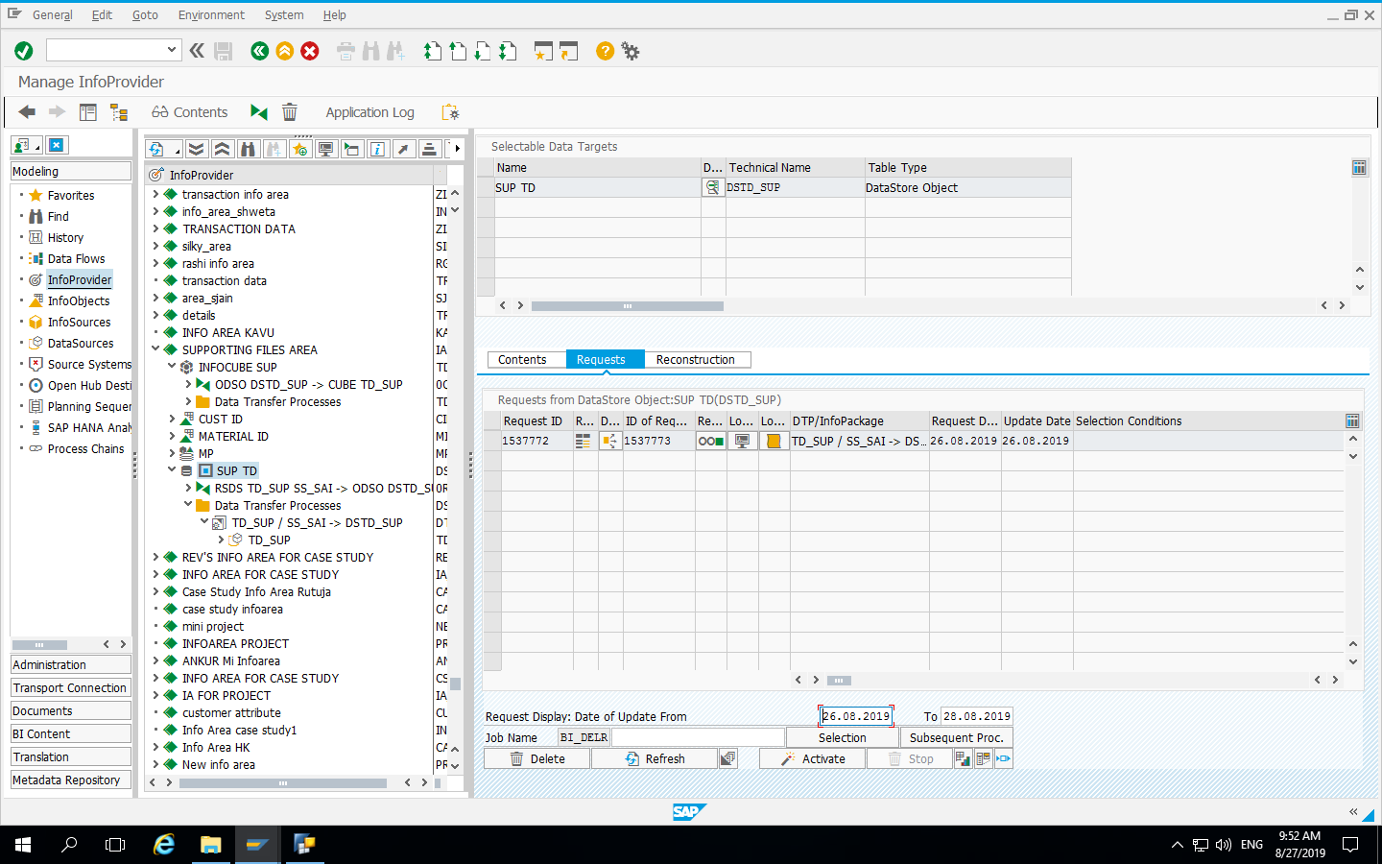
Requests in Data Store Object

Slide 17
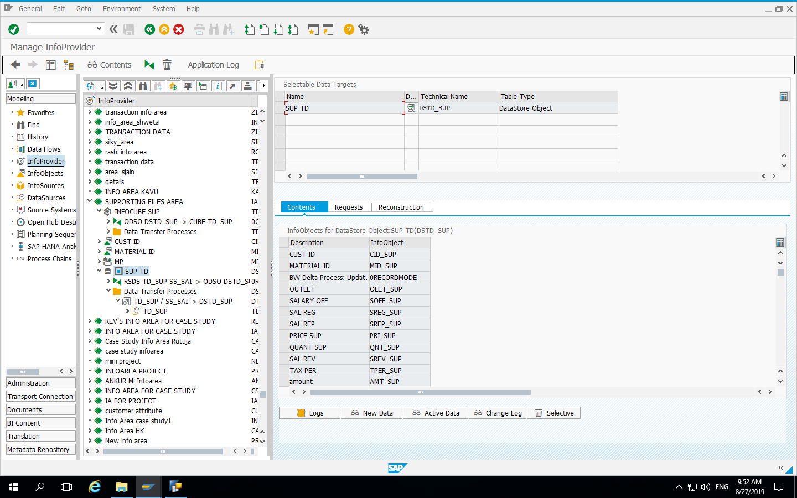
Contents in Data Store Object

Slide 18
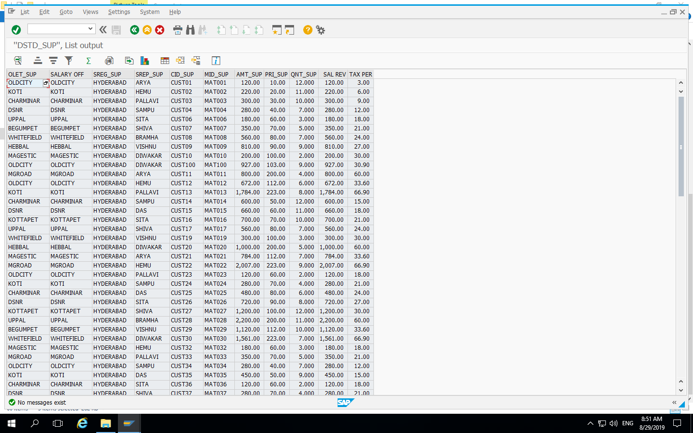
Data in Data Store Object

Slide 19
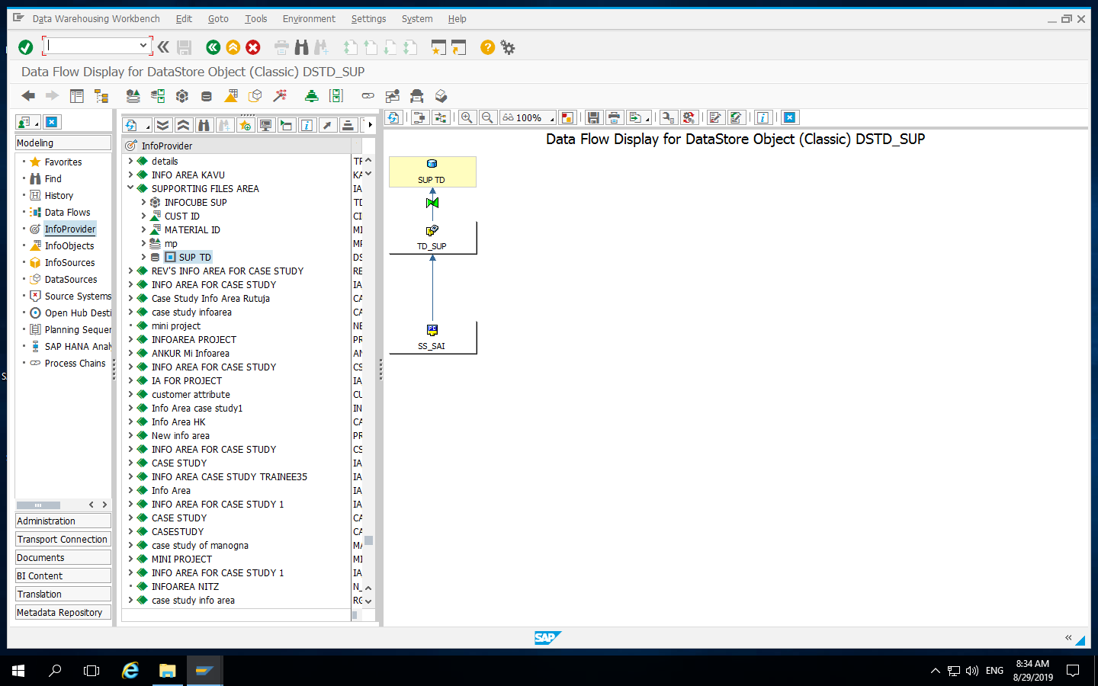
Data Flow for Data Store Object

Slide 20
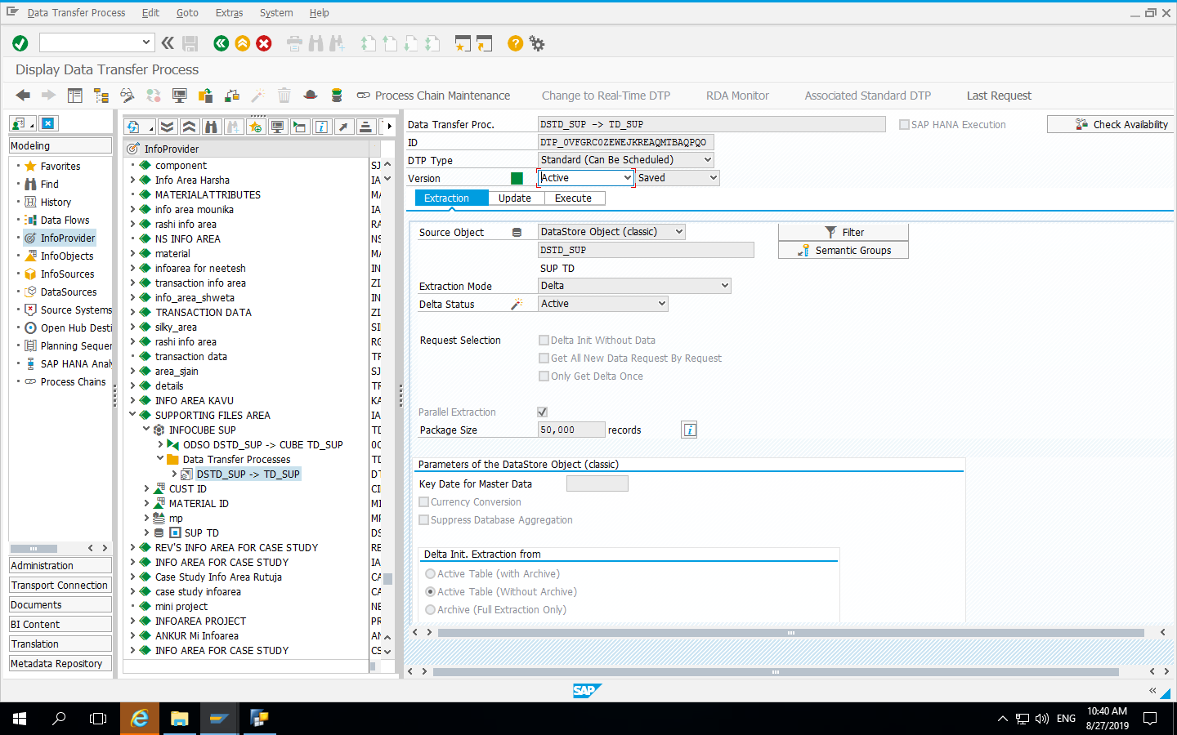
Execution of Data Transfer Process of Infocube

Slide 21
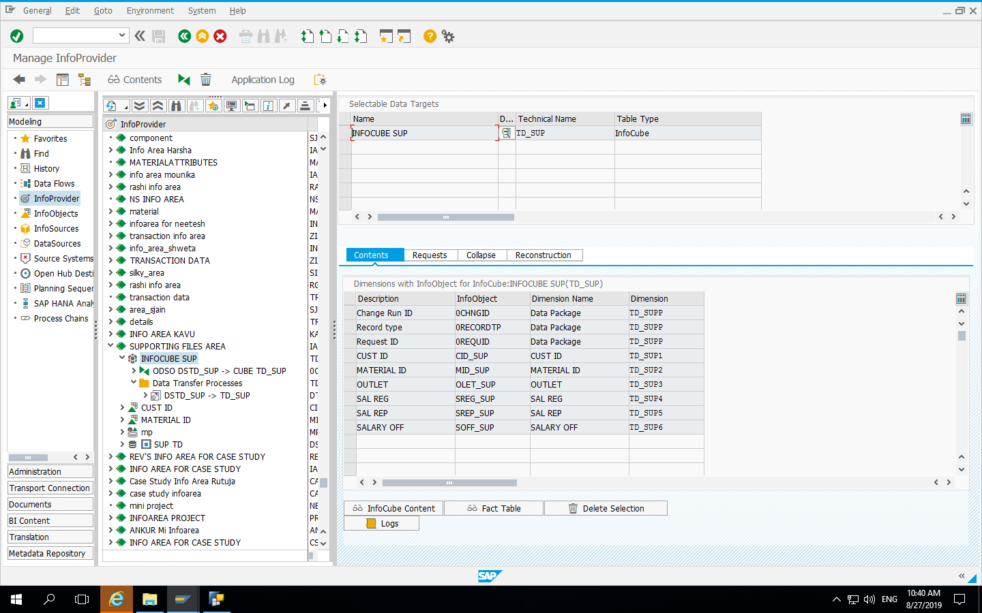
Contents of Infocube

Slide 22
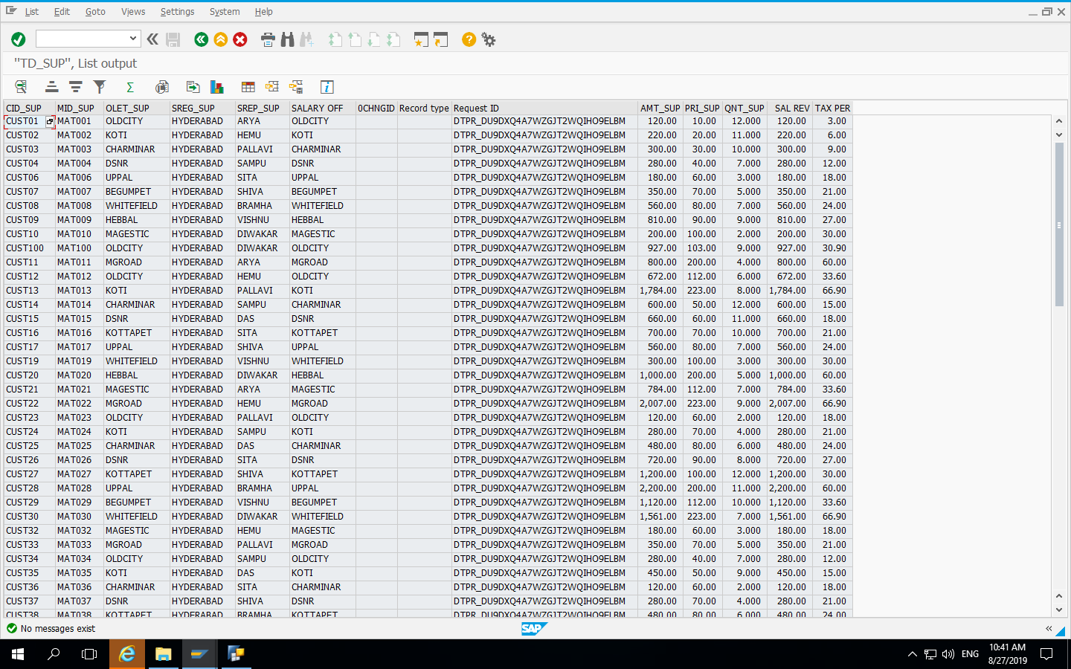
Data of Infocube

Slide 23
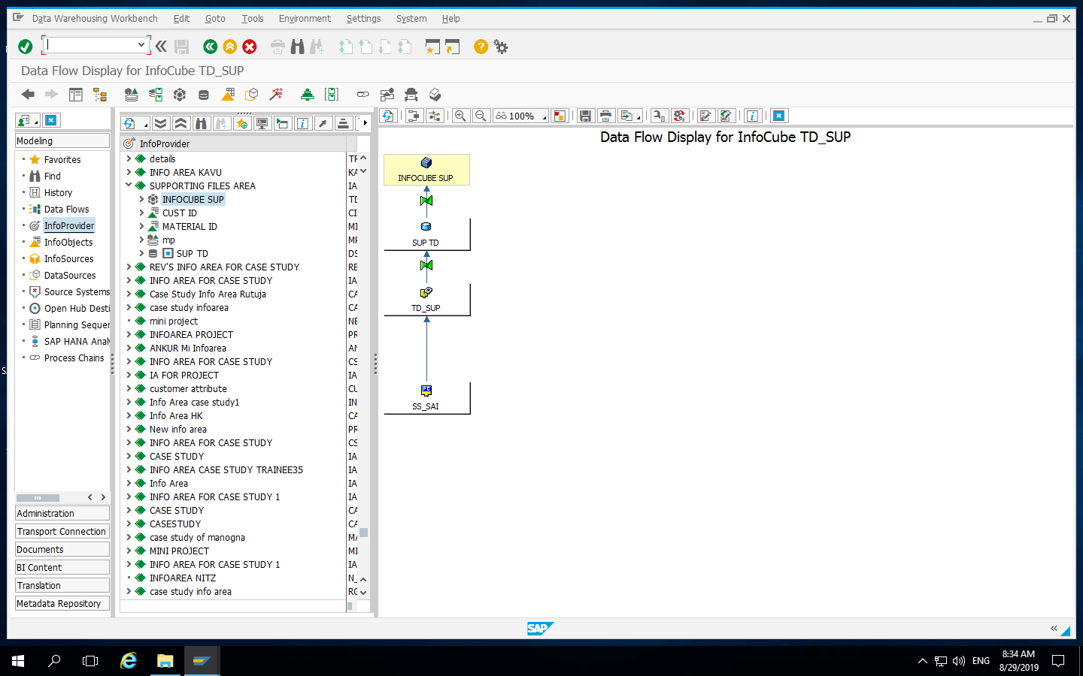
Data flow for InfoCube

Slide 24
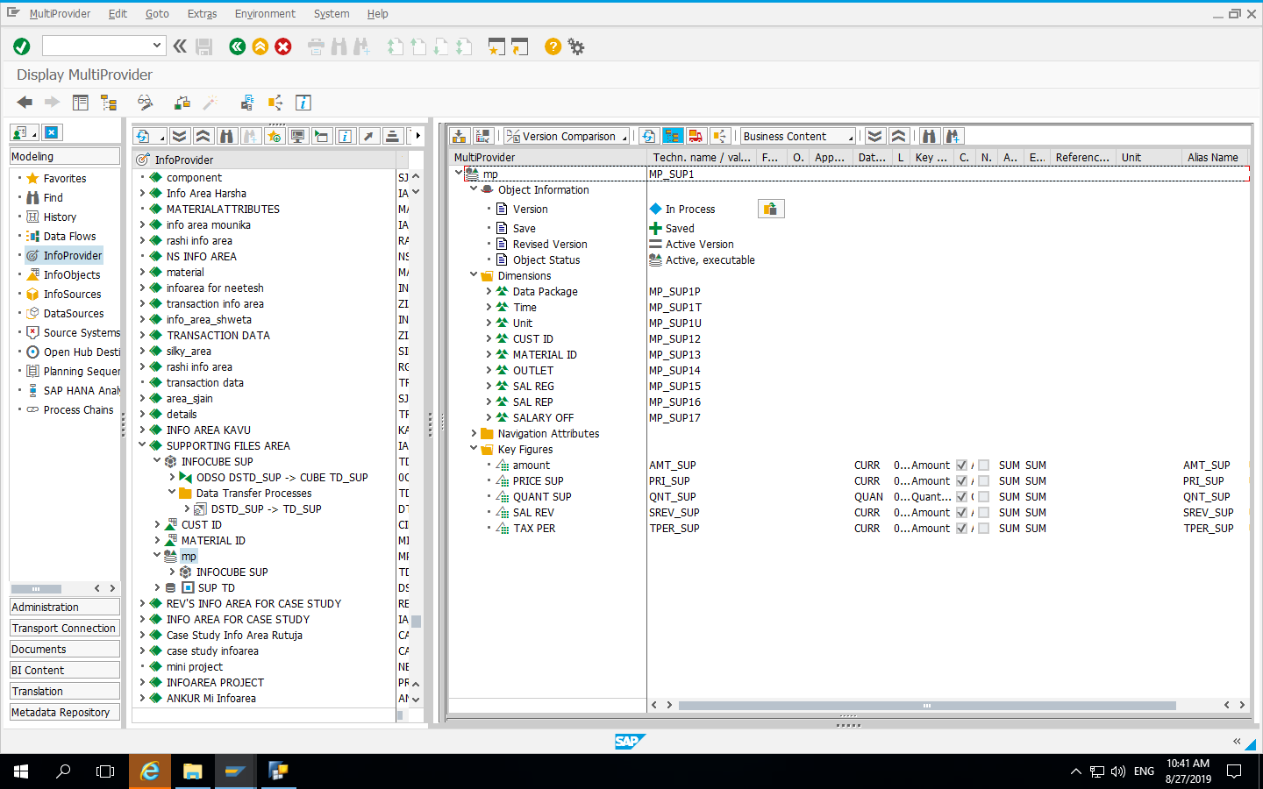
Multiprovider with Dimensions and Key Figures

Slide 25
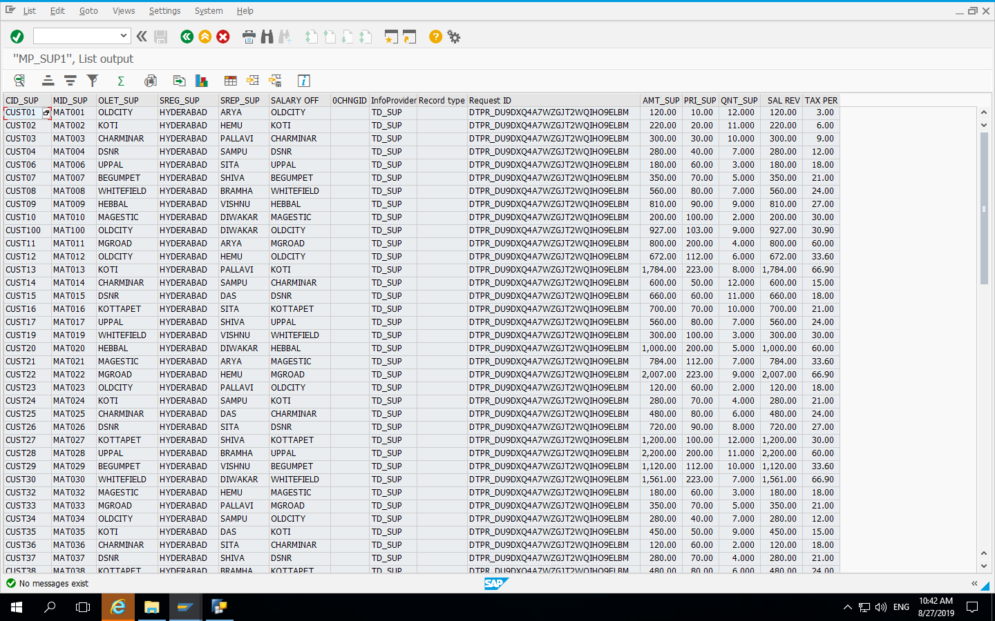
Data of MultiProvider

Slide 26
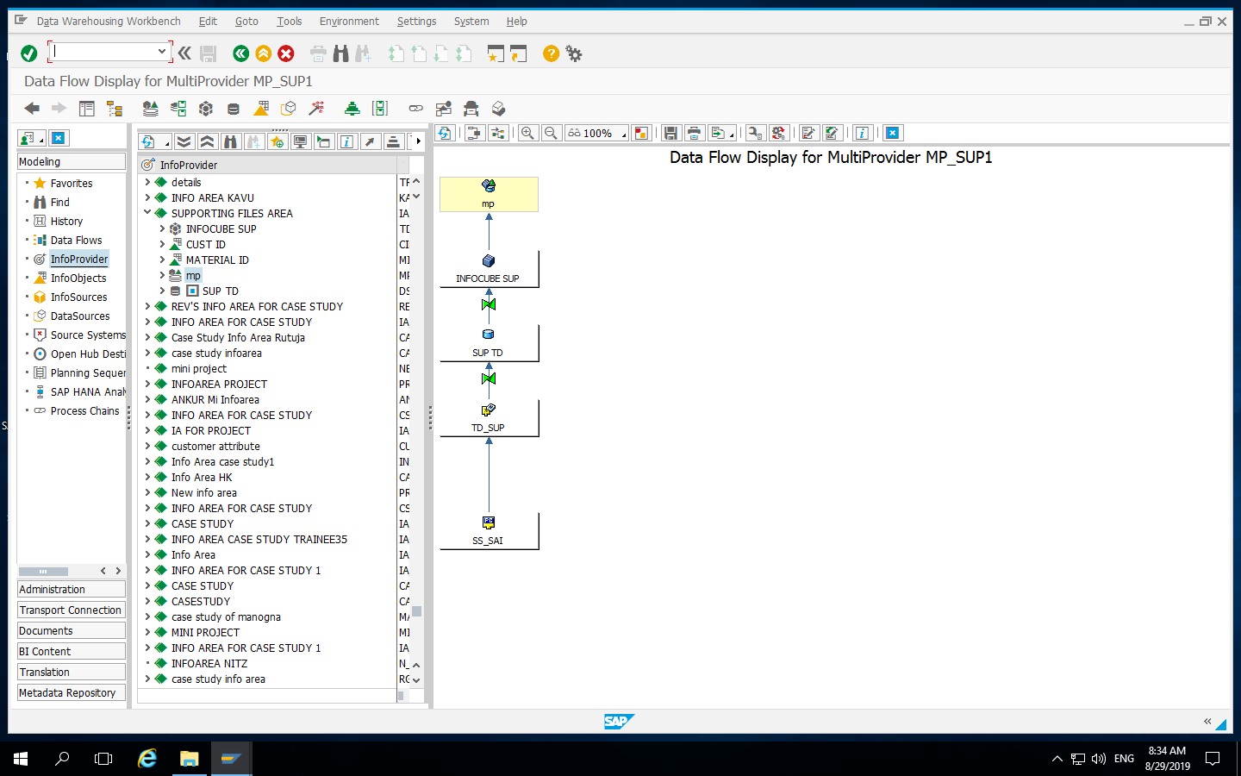
Data Flow for MultiProvider

Slide 27
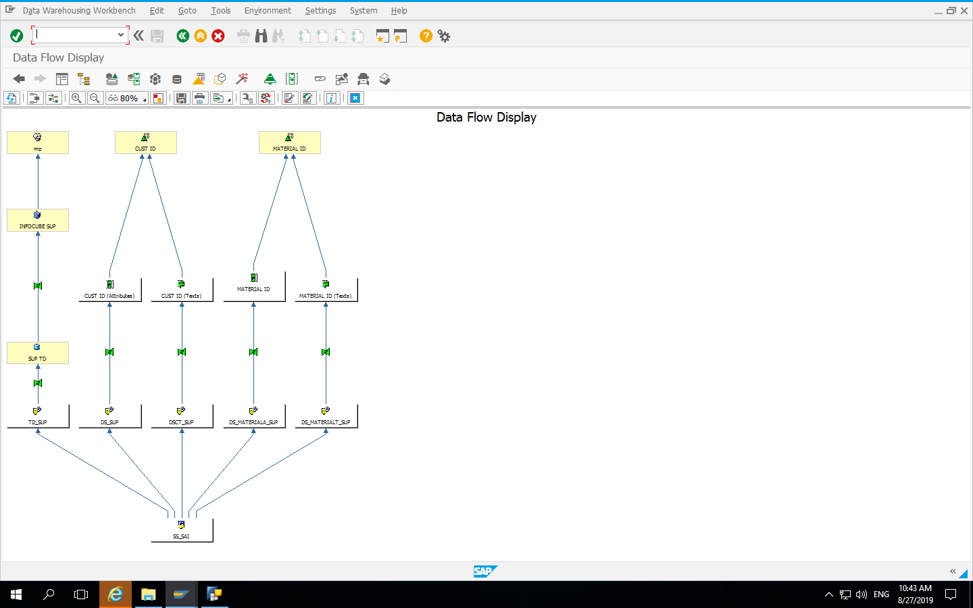
Final Data Flow Display

Slide 28
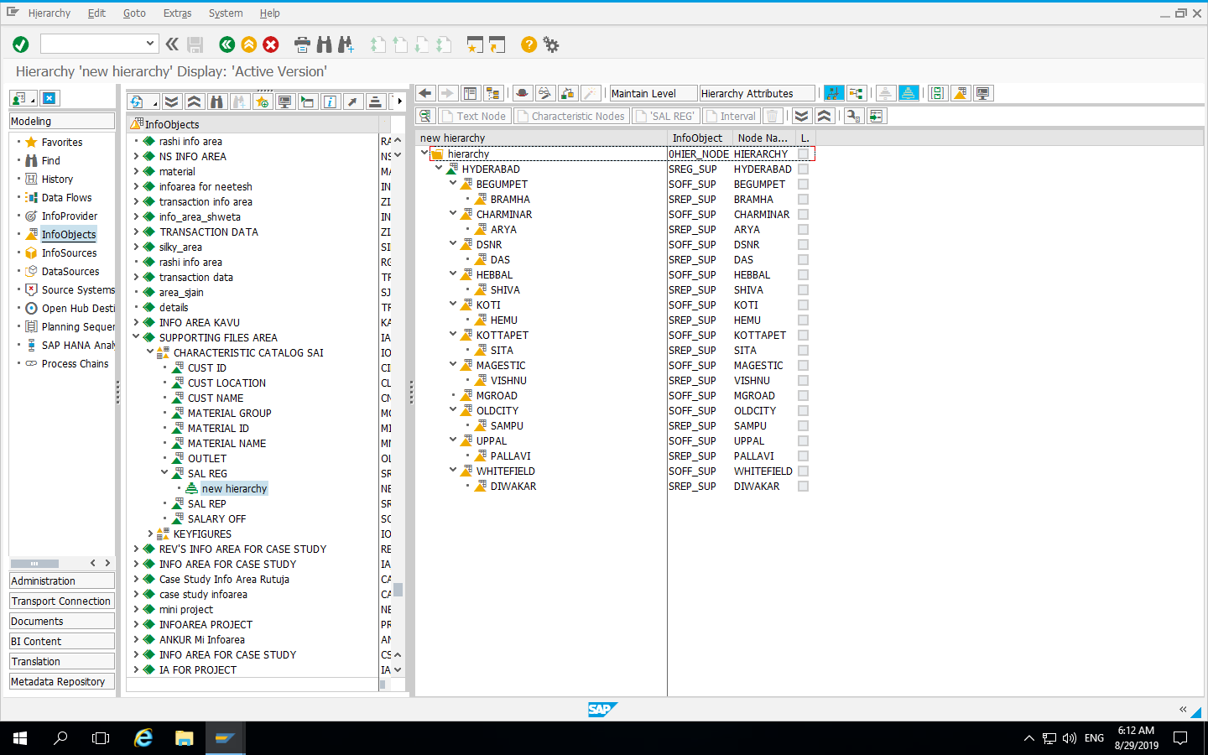
Hierarchy for Sales Region

Slide 29
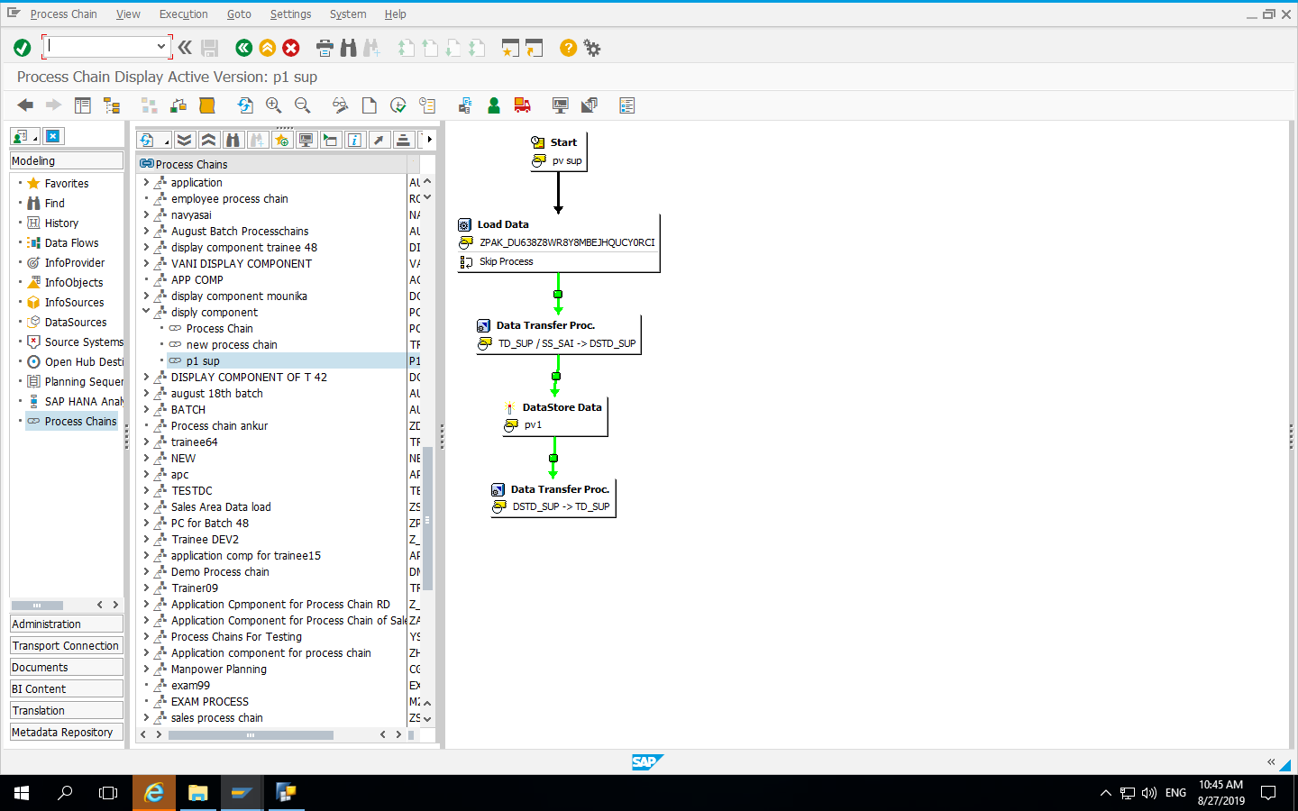
Process Chain

Slide 30
BeX Queries

Slide 31
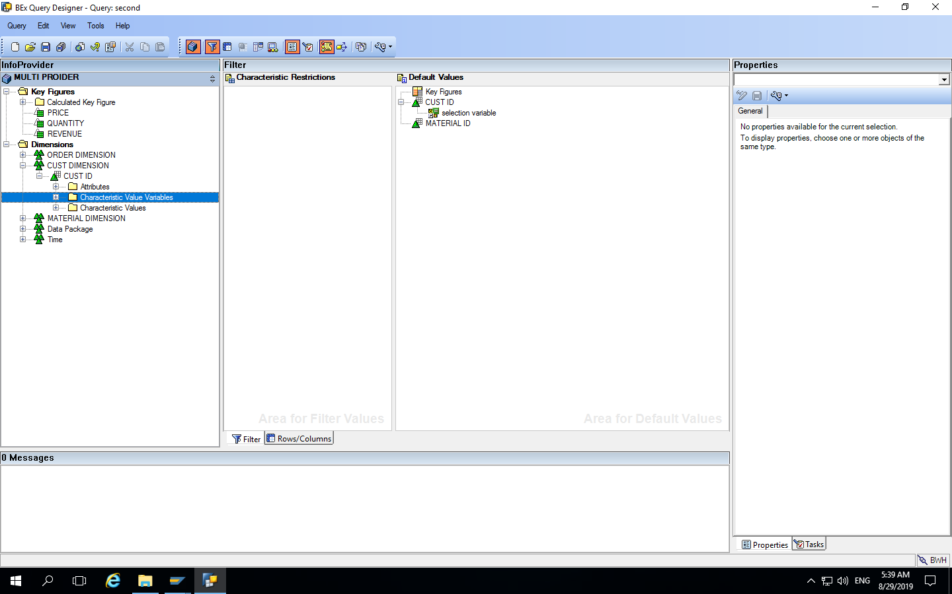
Variable Creation

Slide 32
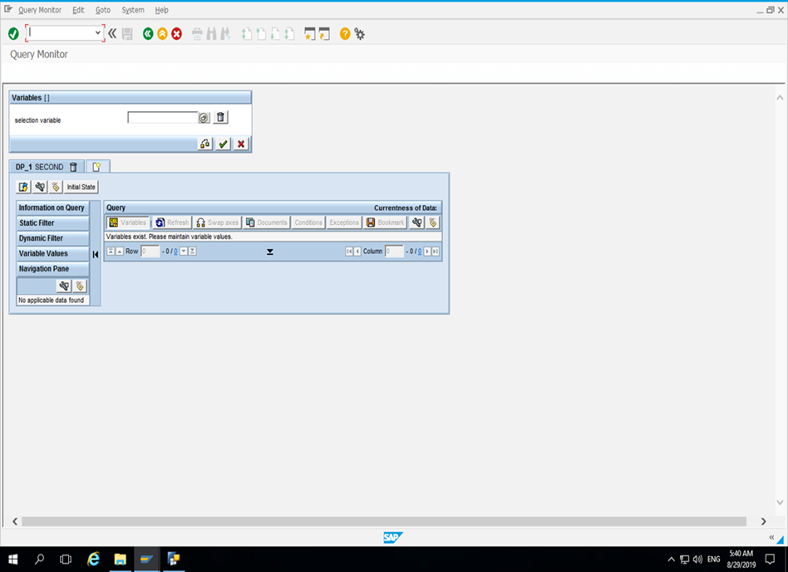
Selection of our choice with Variable

Slide 33
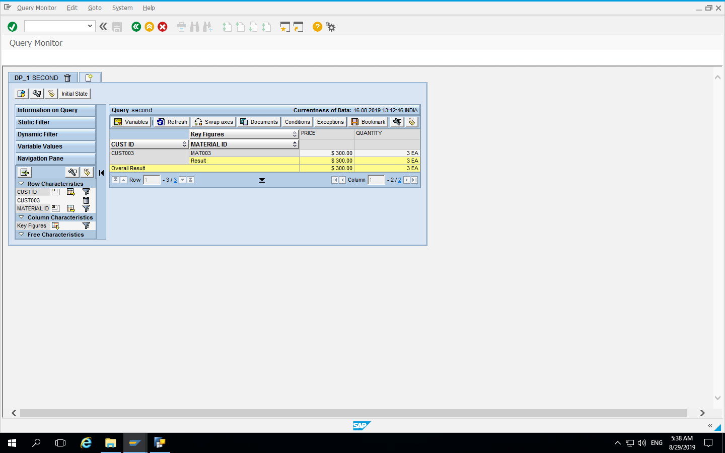
Final report of our choice

Slide 34
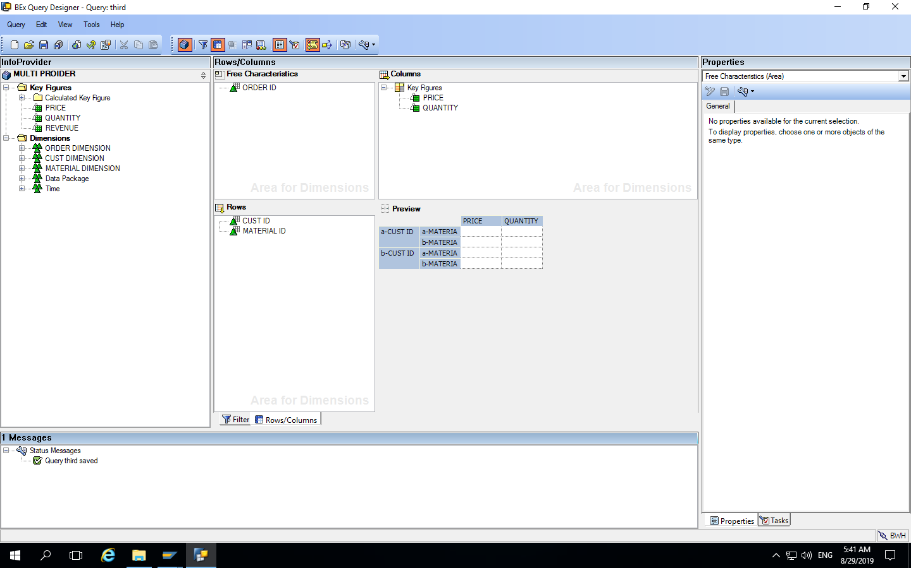
Using Free Characteristics

Slide 35
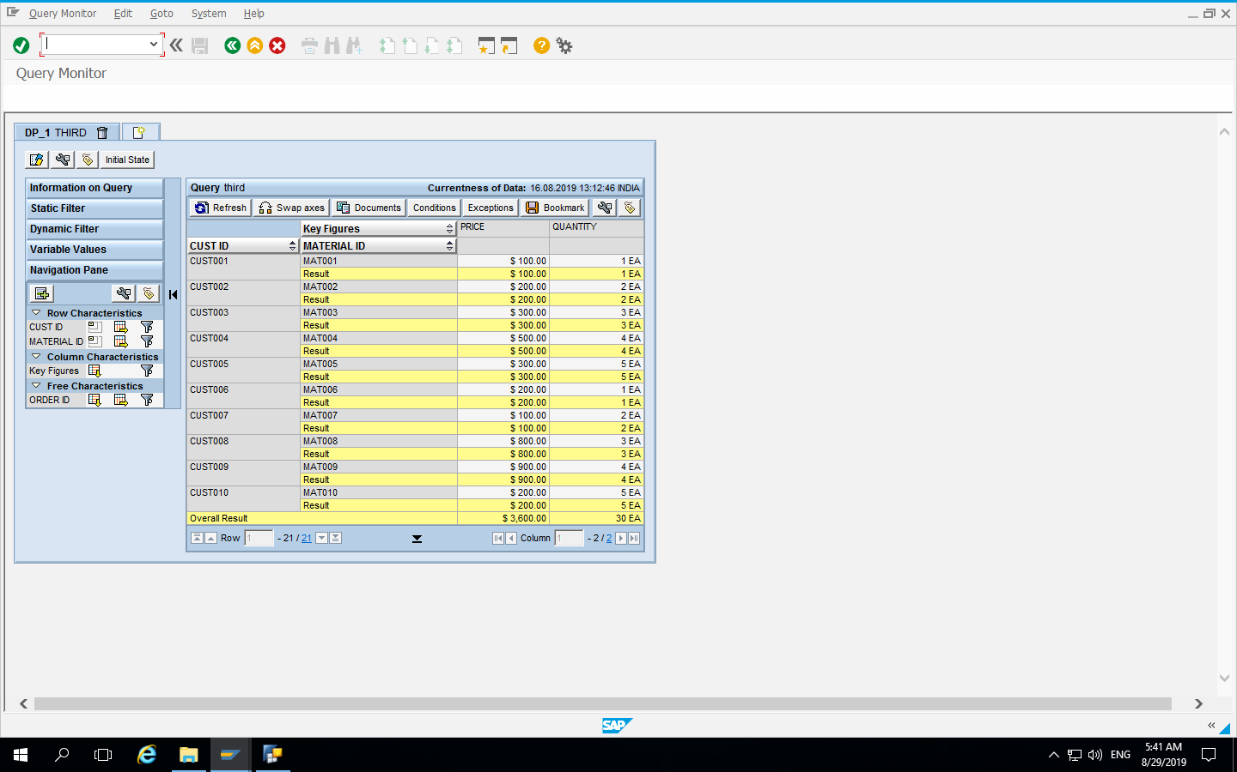
Final Report with choice of Free Characteristic

Slide 36
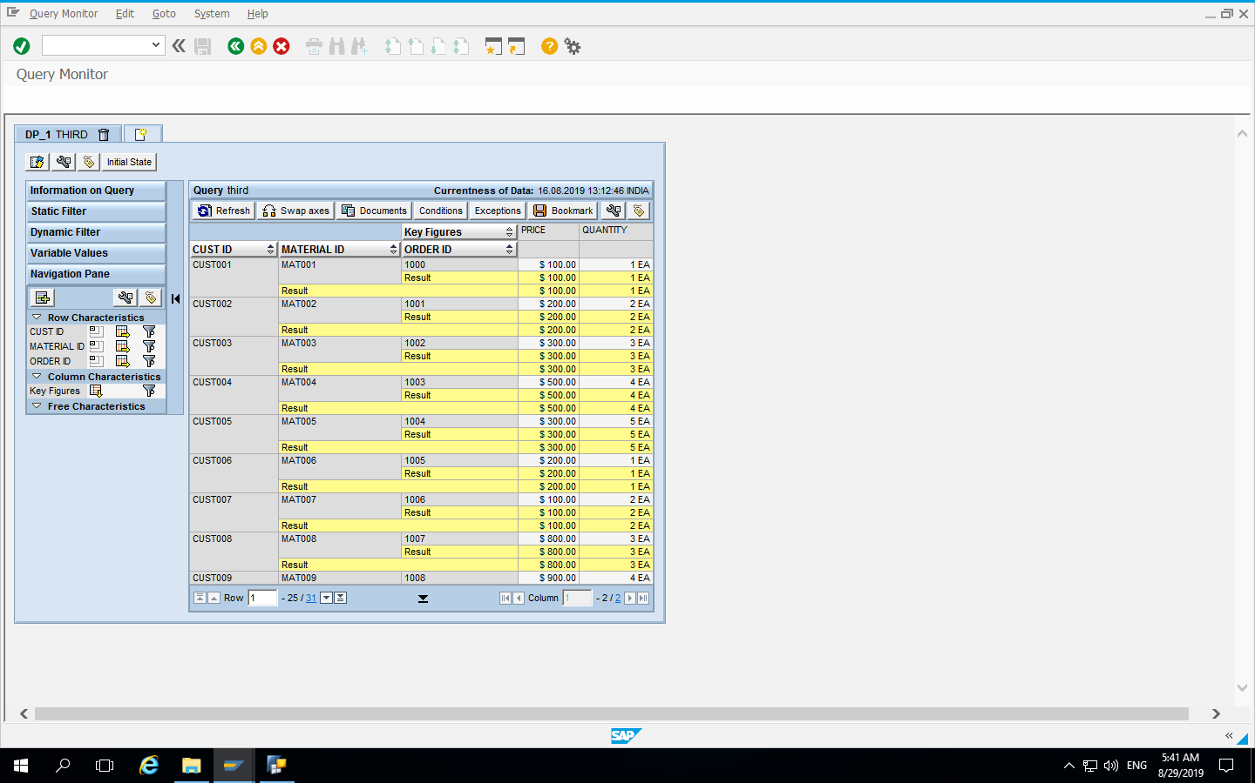
Final Report with Free Characteristic

Slide 37
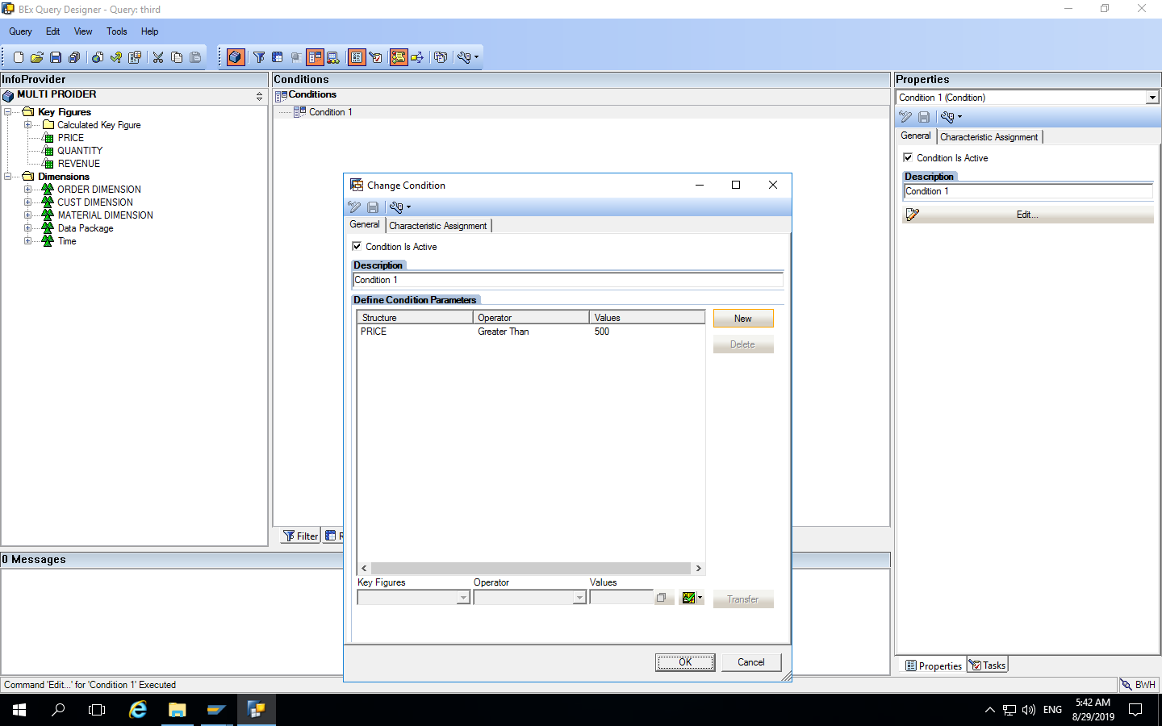
Using Conditions

Slide 38
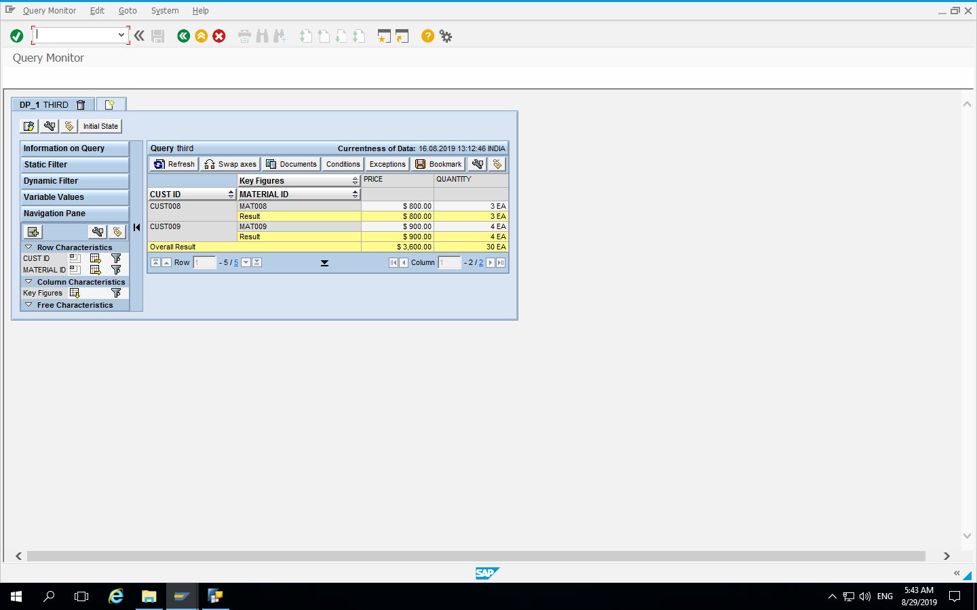
Final Report with condition

Slide 39
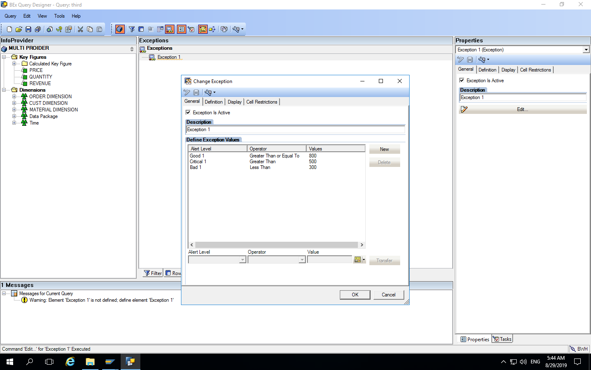
Using Exceptions

Slide 40
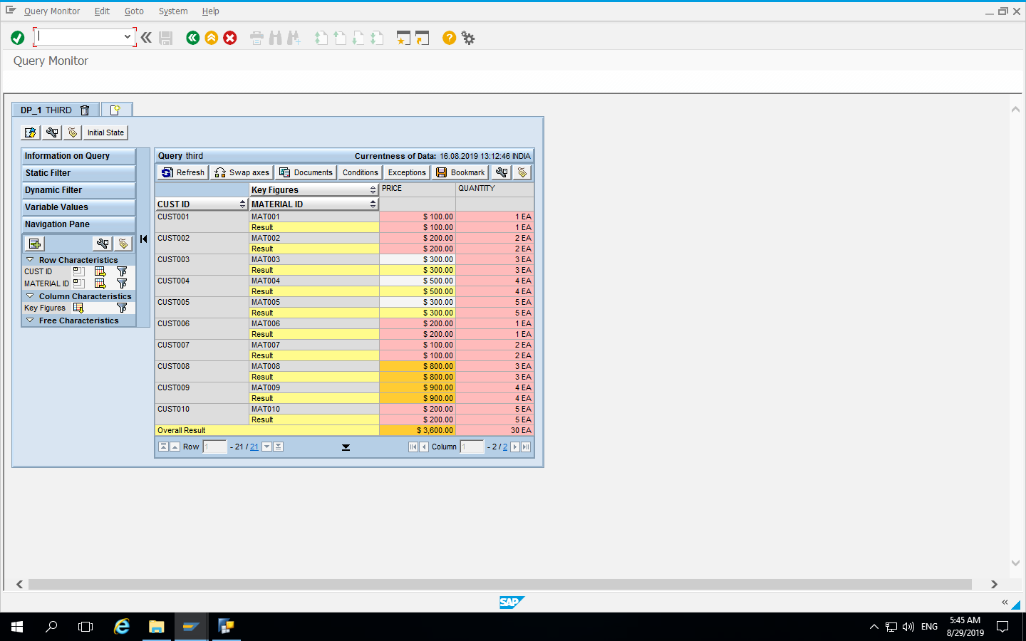
Final Report with Exceptions

Slide 41
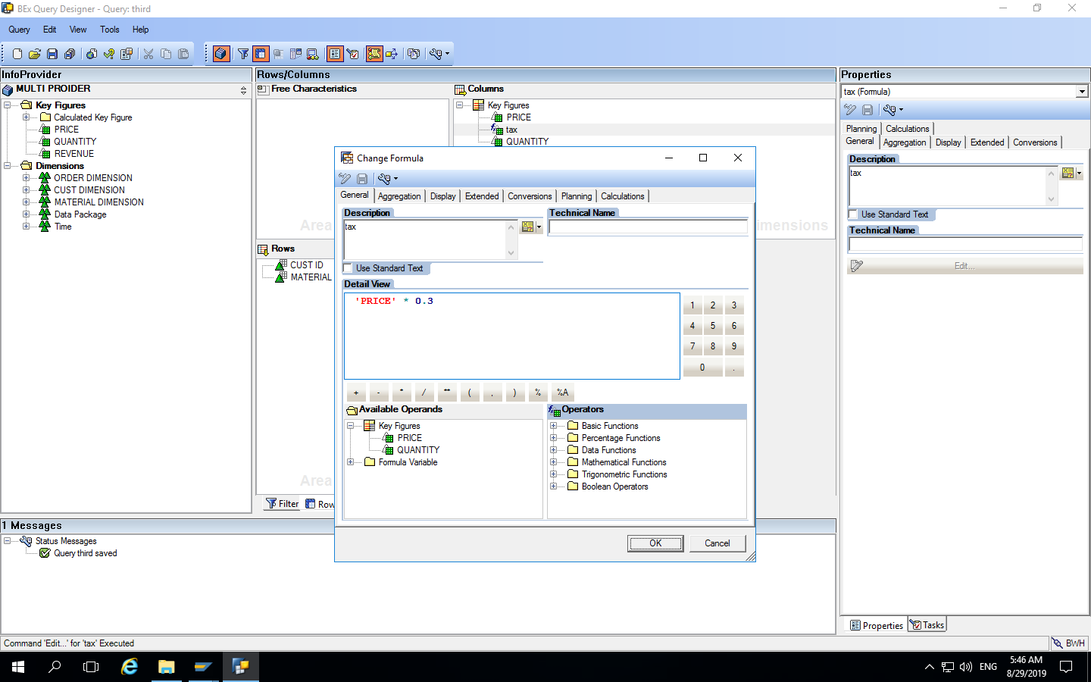
Using Formula

Slide 42
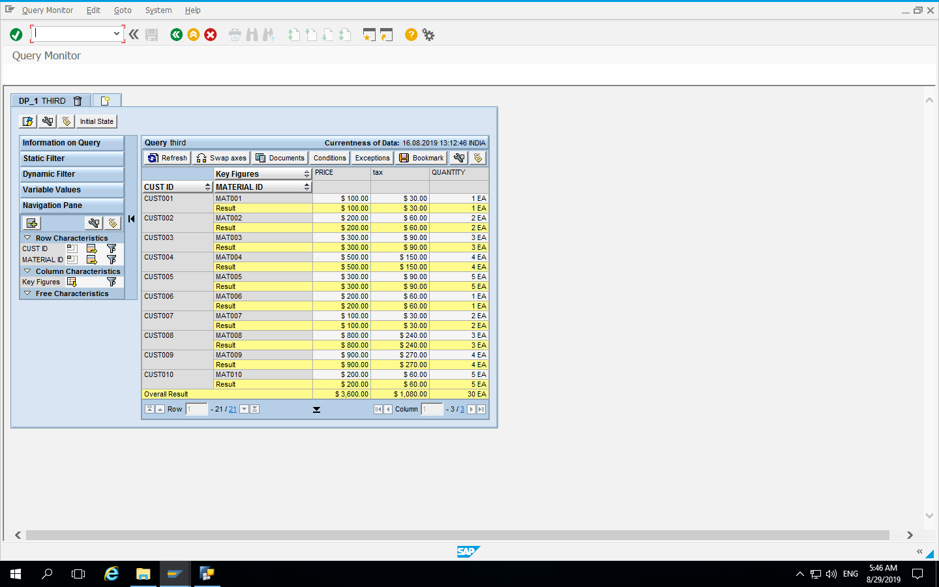
Final Report

Slide 43
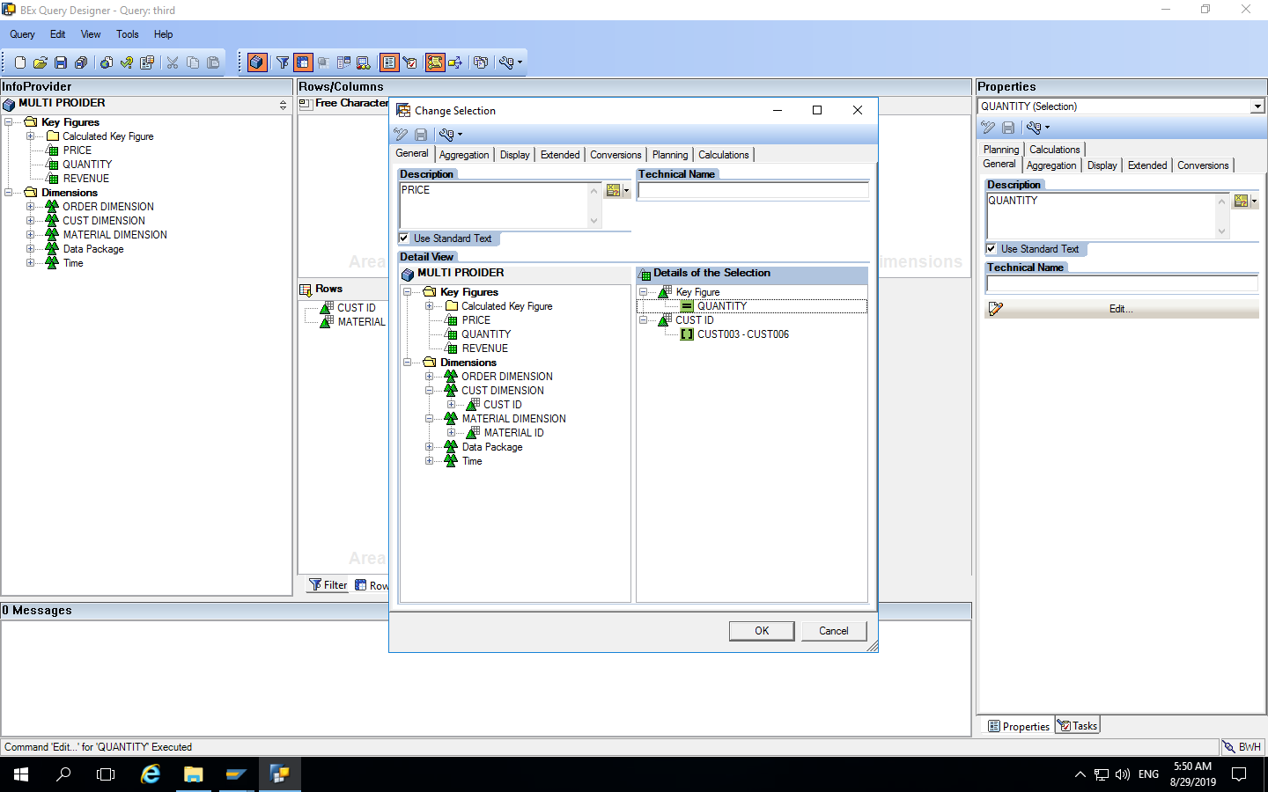
Using Selections

Slide 44

Final Report

Slide 45
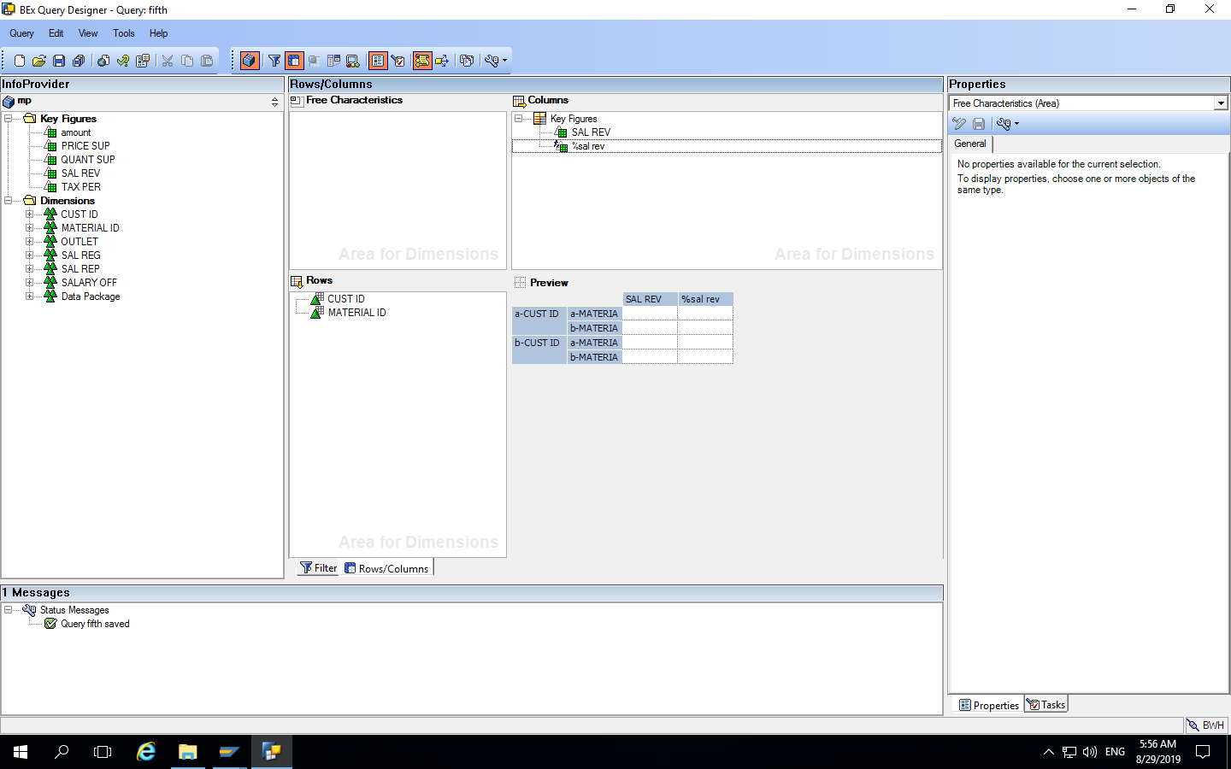
Adding % of Sales Revenue Column with formula

Slide 46
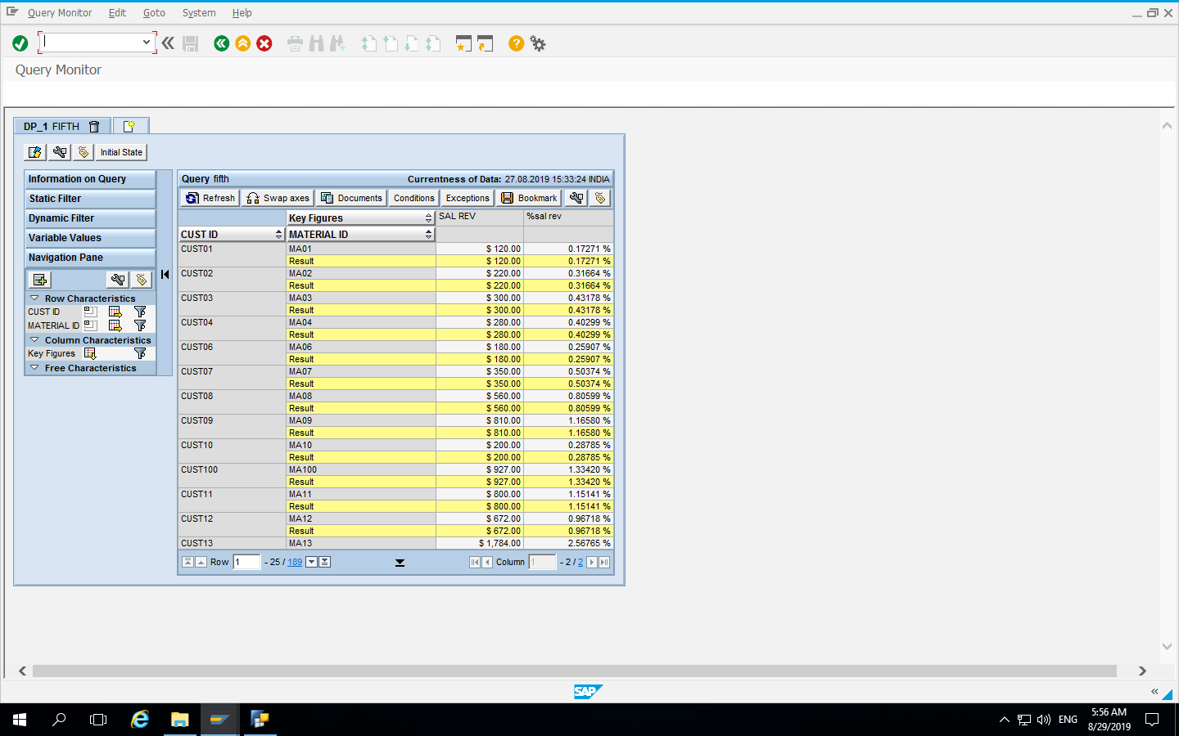
Final Report

Slide 47
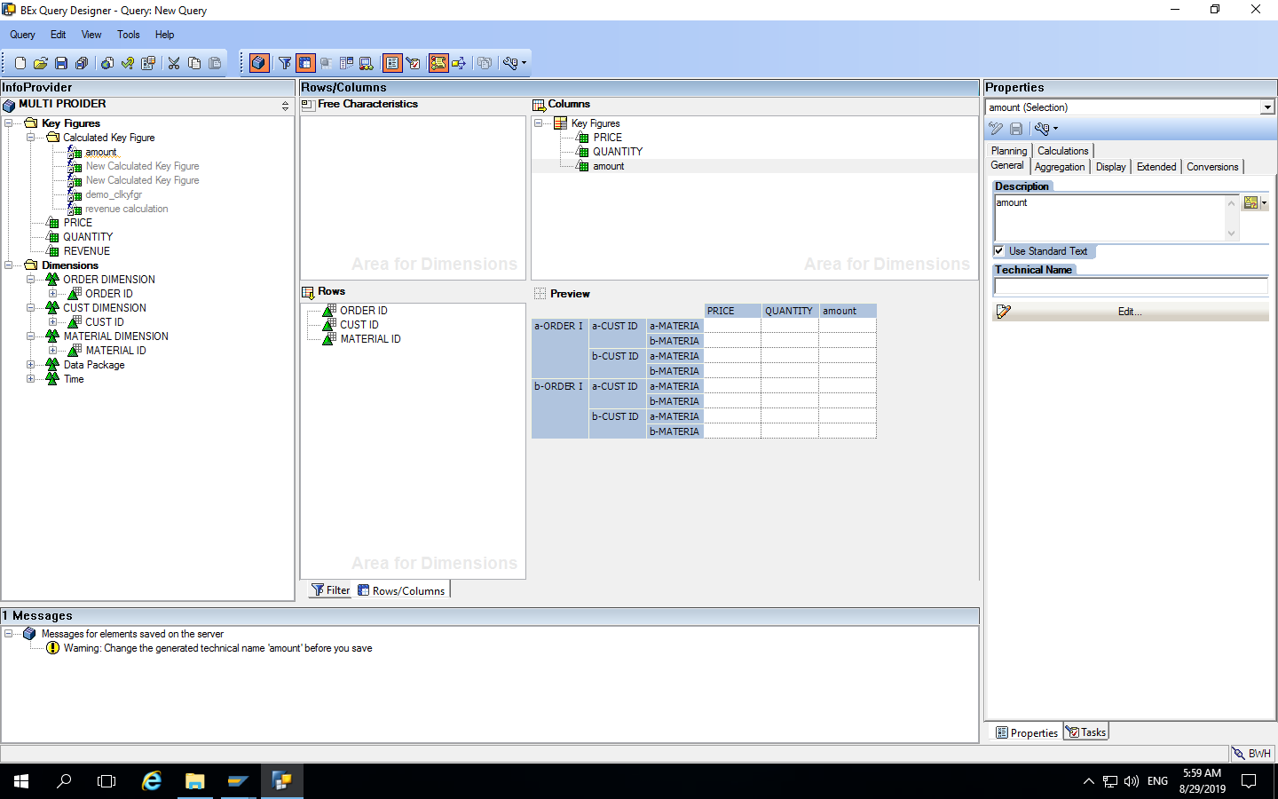
Added Amount Column

Slide 48
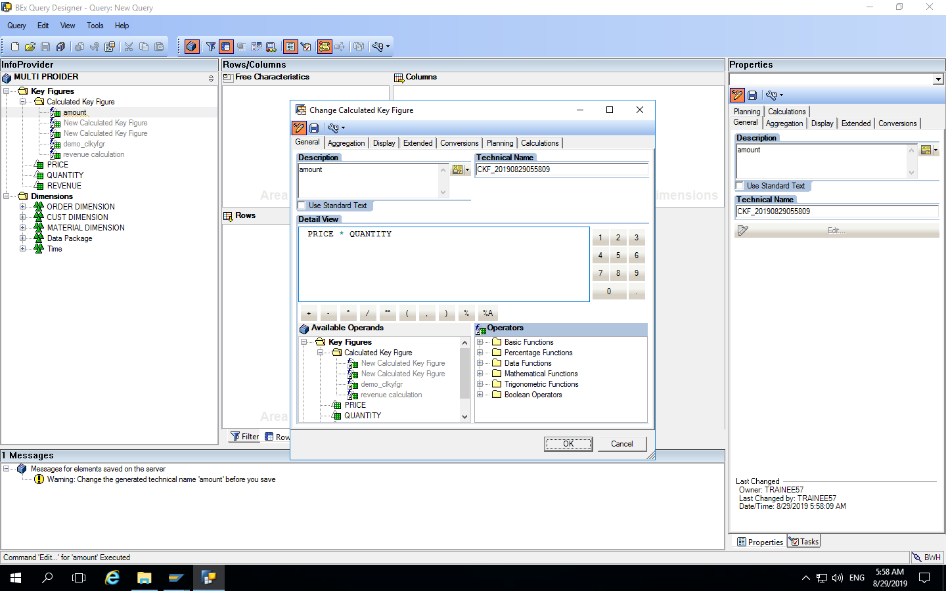
Formula for Amount column

Slide 49
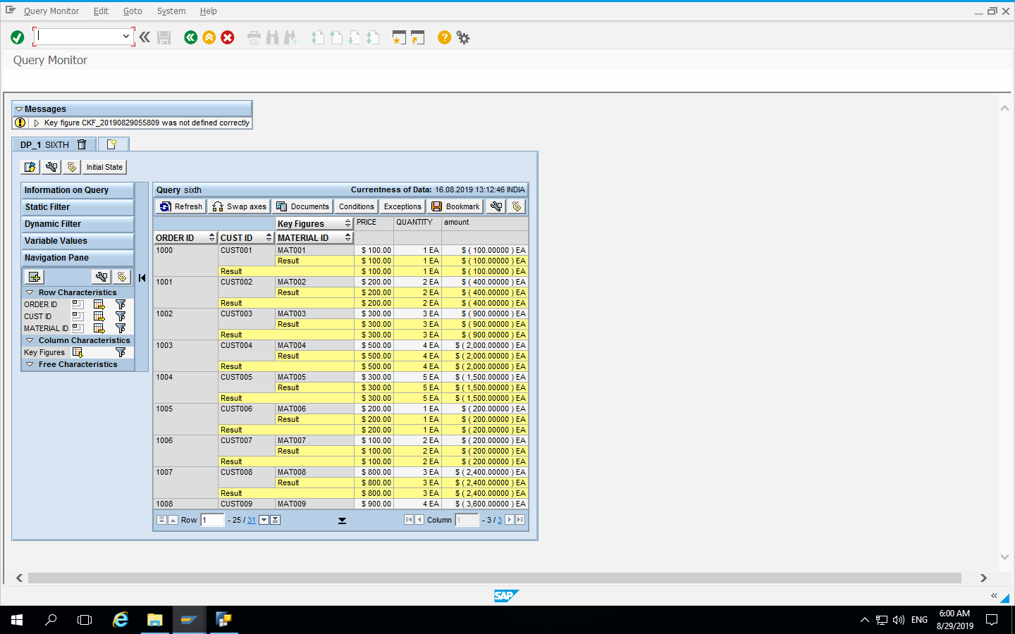
Final Report

Slide 50
Conclusion
All the Objects have been created as per the given Business Requirement.
Sales Analysis report for Tesco has been generated using BeX Query Designer.

Slide 51


